Slide 1
Chapter 9 Counters

Slide 2
Outline
Asynchronous Counter Operation
Synchronous Counter Operation
Up/Down Synchronous Counters
Design of Synchronous Counters
Cascaded Counters
Counter Decoding
Counter Applications

Slide 3
9.1 Asynchronous Counter Operation (异步计数器)
Asynchronous
  Events do not have a fixed time relationship with each other
  Events do not occur at the same time
An asynchronous counter
  The Flip-flops within the counter do not change states at exactly the same time
  The Flip-flops within the counter do not have a common clock pulse

Slide 4
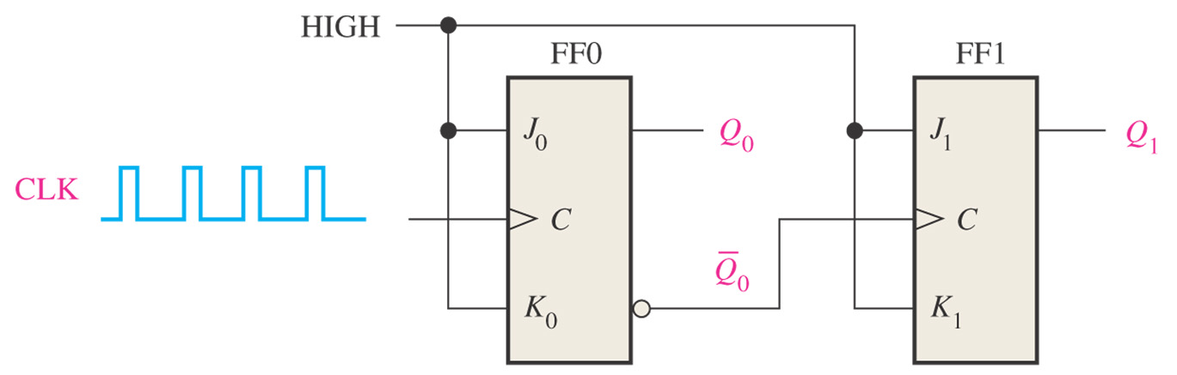
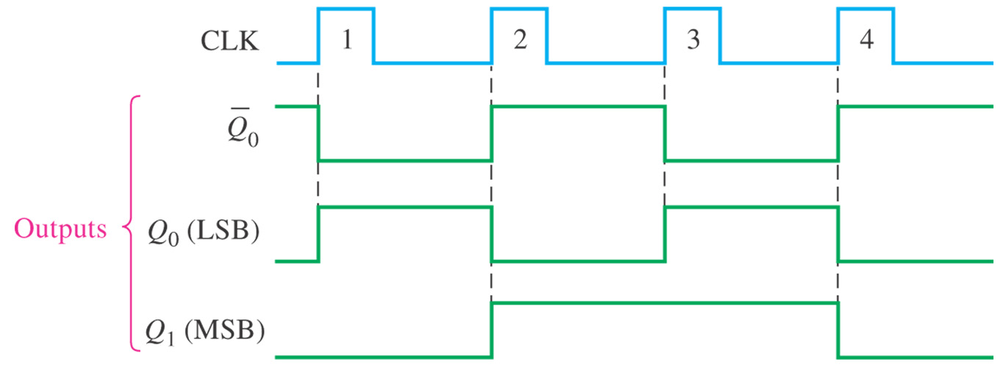
A 2-bit Asynchronous Binary Counter

Slide 5
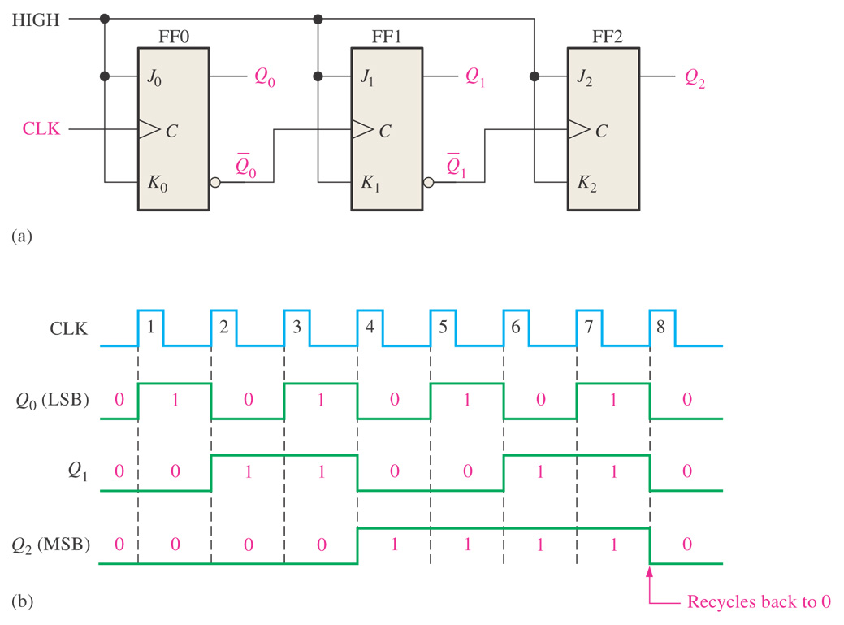
A 3-bit Asynchronous Binary Counter

Slide 6
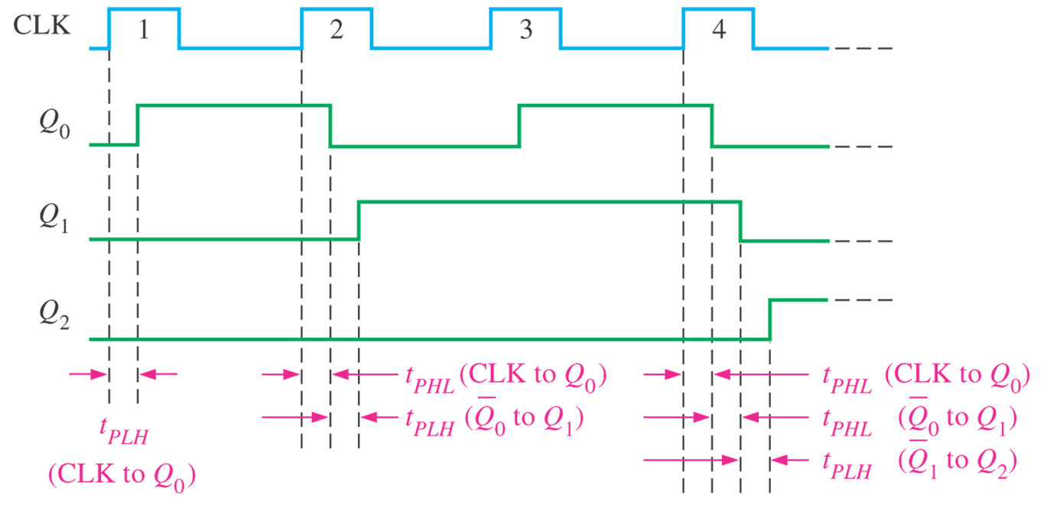
Propagation Delay
Figure 8–4 Propagation delays in a 3-bit asynchronous (ripple-clocked) binary counter.

Slide 7
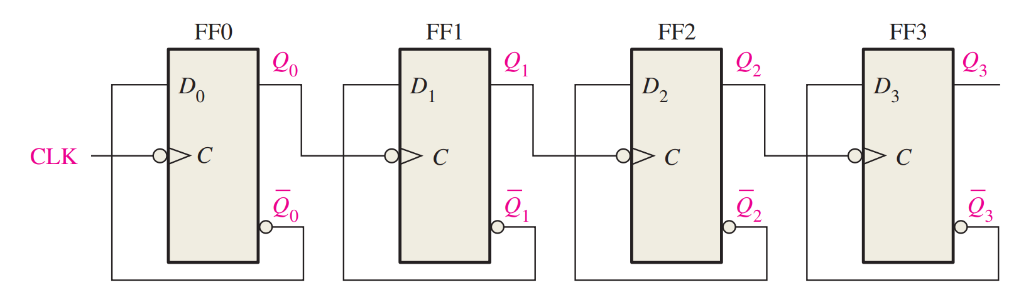
A 4-bit asynchronous binary counter is shown in Figure 9–8(a). Each D flip-flop is negative edge-triggered and has a propagation delay for 10 nanoseconds (ns). Develop a timing diagram showing the Q output of each flip-flop, and determine the total propagation delay time from the triggering edge of a clock pulse until a corresponding change can occur in the state of Q3. Also determine the maximum clock frequency at which the counter can be operated.

Slide 8
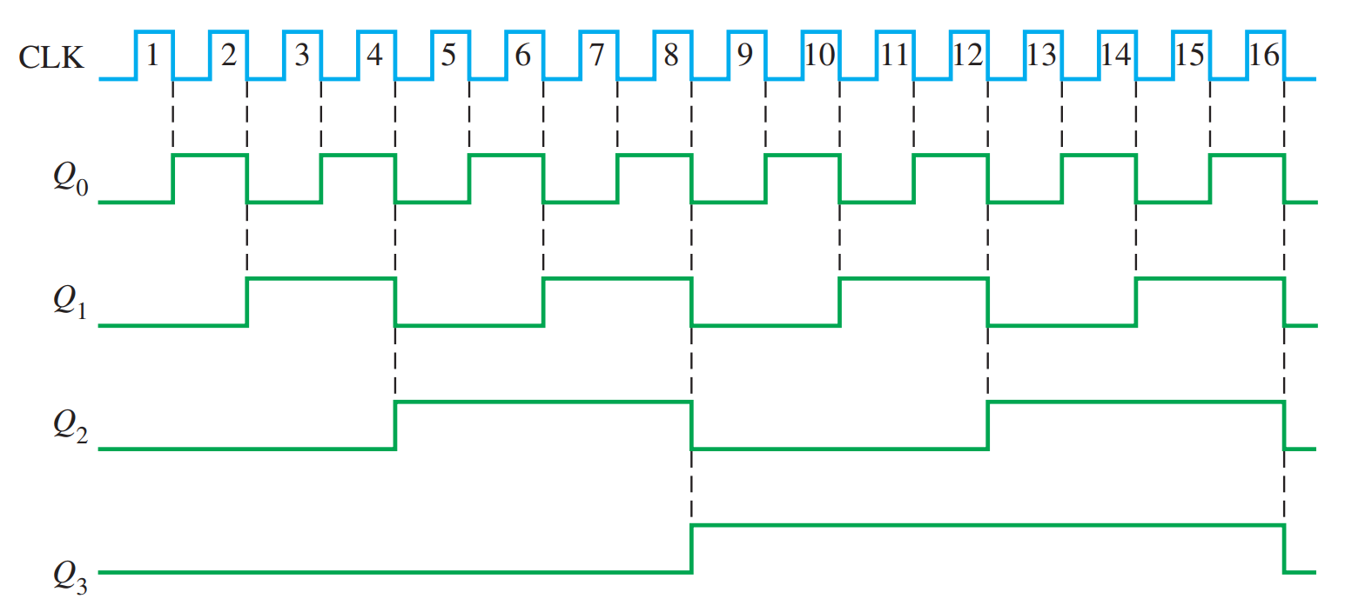
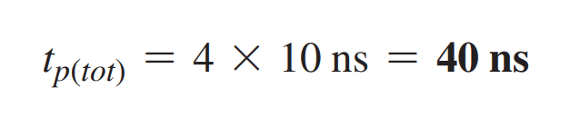
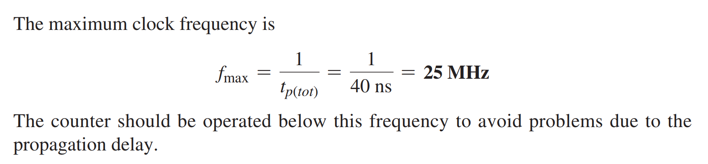

Slide 9
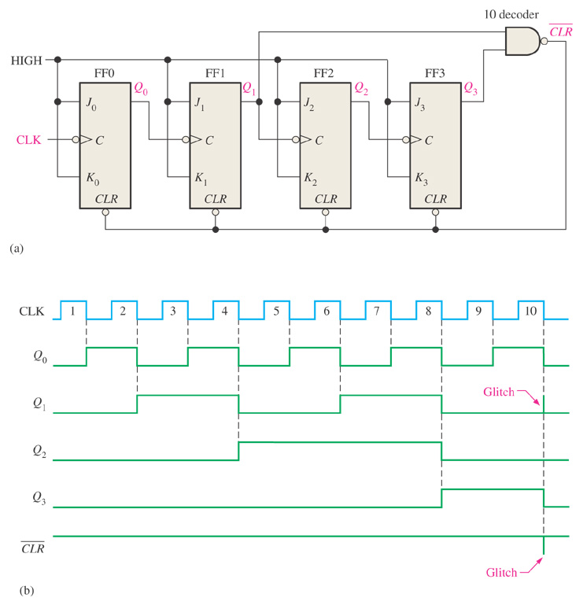
Asynchronous Decade Counters
Figure 8–6 An asynchronously clocked decade counter with asynchronous recycling.

Slide 10
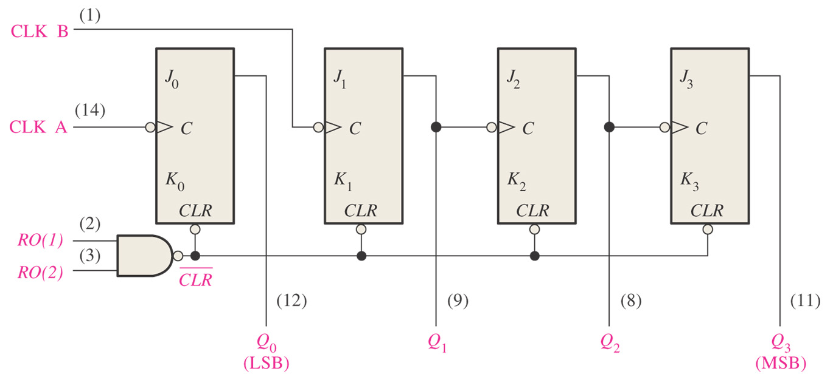
74LS93

Slide 11
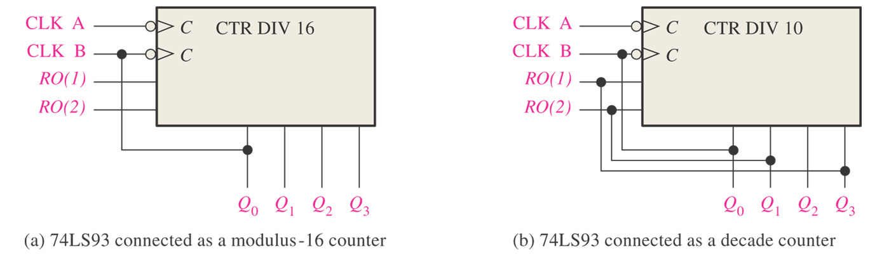
Figure 8–9 Two configurations of the 74LS93 asynchronous counter.

Slide 12
How to use 74LS93 as a modulus-12 counter?

Slide 13
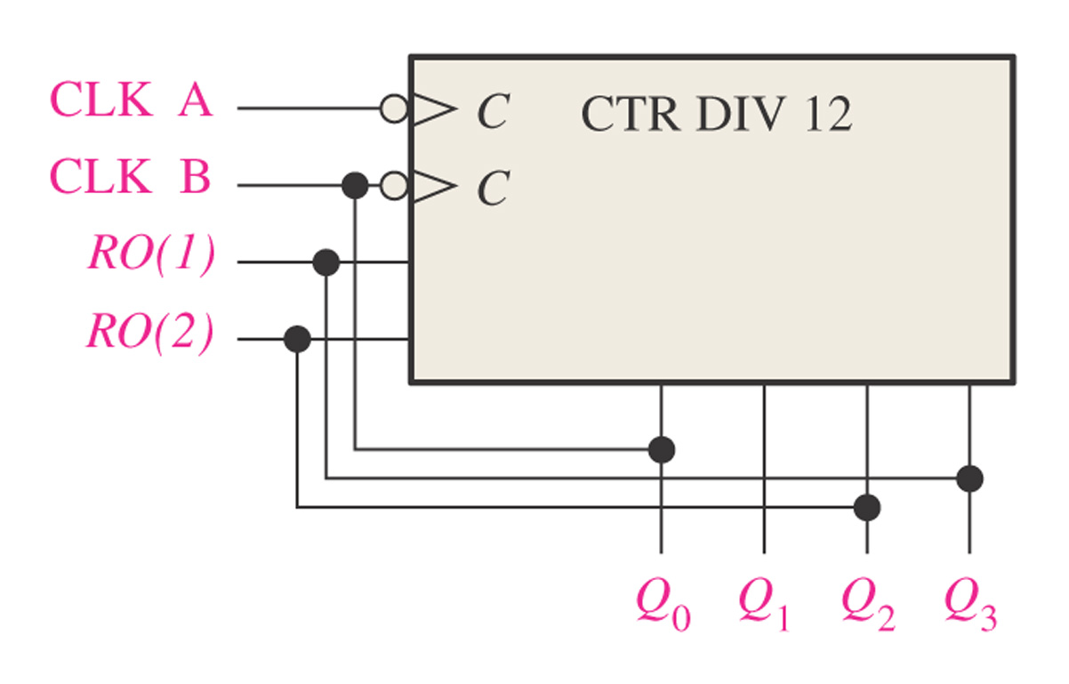
Figure 8–10 74LS93 connected as a modulus-12 counter.

Slide 14
8.2 Synchronous Counter Operation (同步计数器)
Synchronous
  Events have a fixed time relationship with each other
A synchronous counter
  All Flip-flops within the counter are clocked at the same time by a common clock pulse

Slide 15
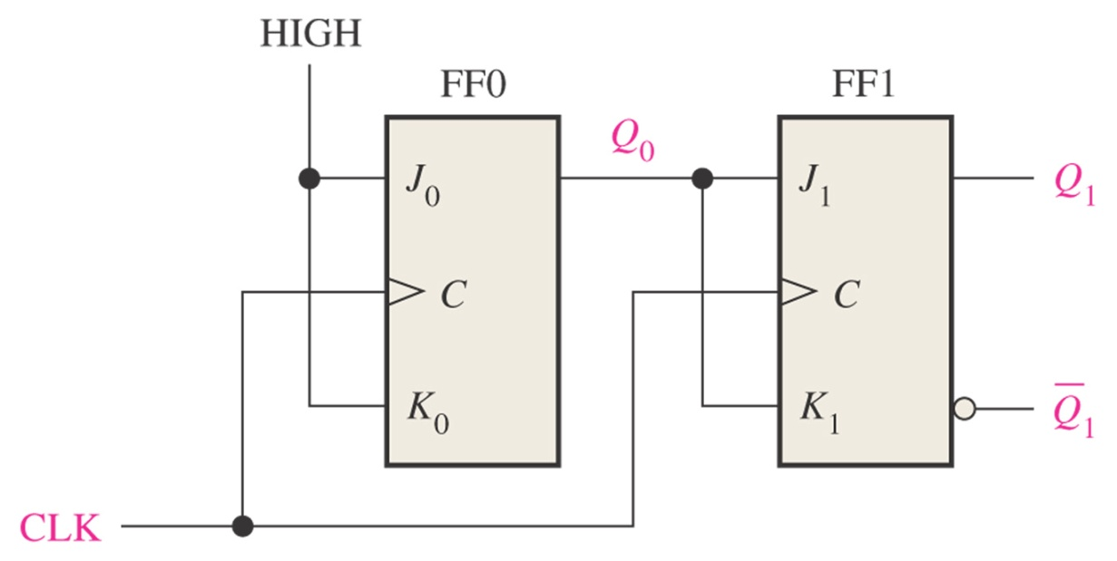
A 2-bit Synchronous Binary Counter
Figure 8–11 A 2-bit synchronous binary counter.

Slide 16
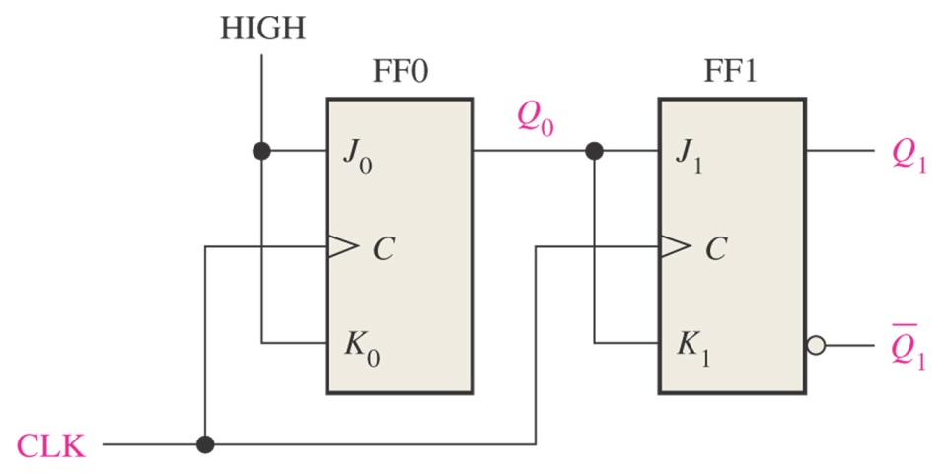
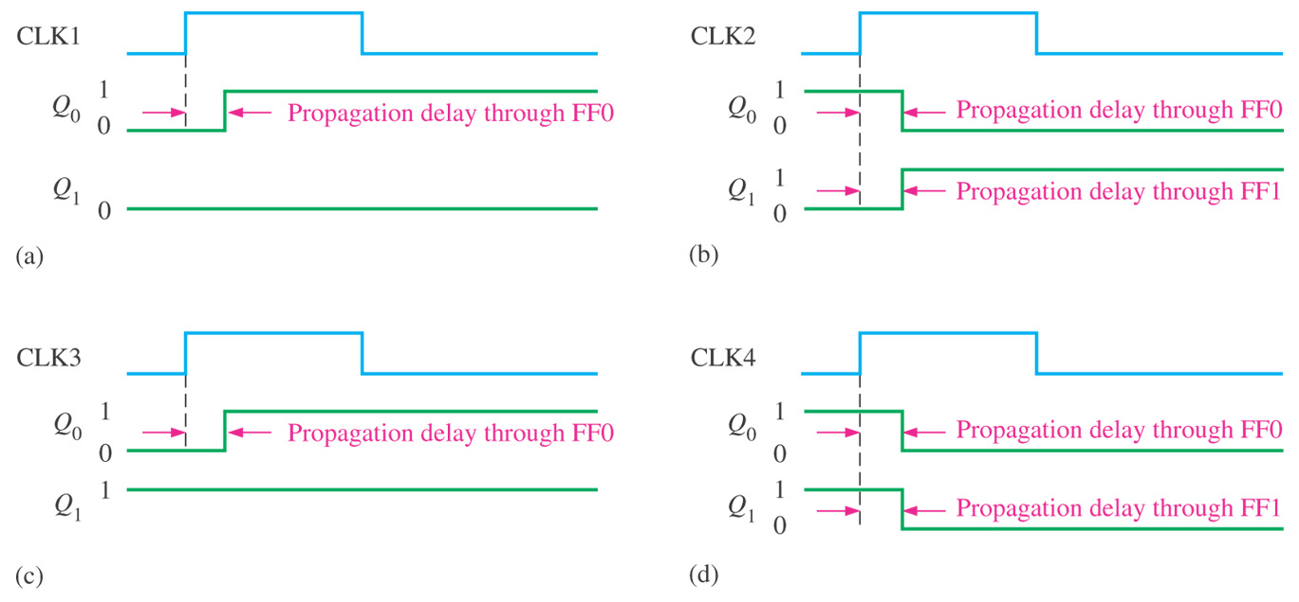
Figure 8–12 Timing details for the 2-bit synchronous counter operation (the propagation delays of both flip-flops are assumed to be equal).

Slide 17
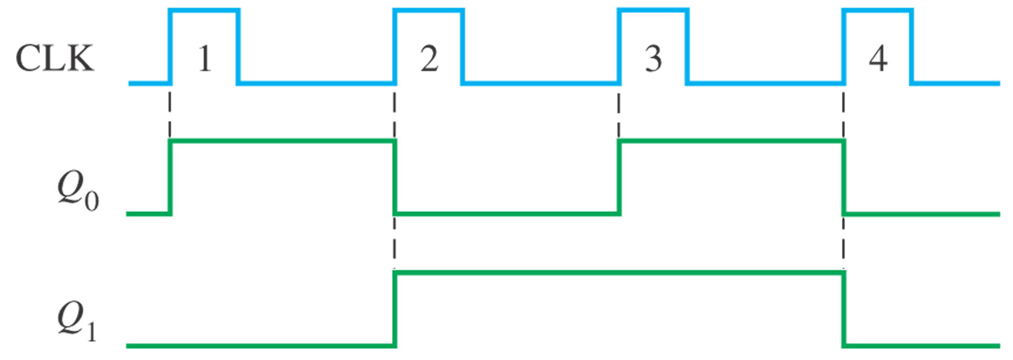
Figure 8–13 Timing diagram for the counter of Figure 8–11.

Slide 18
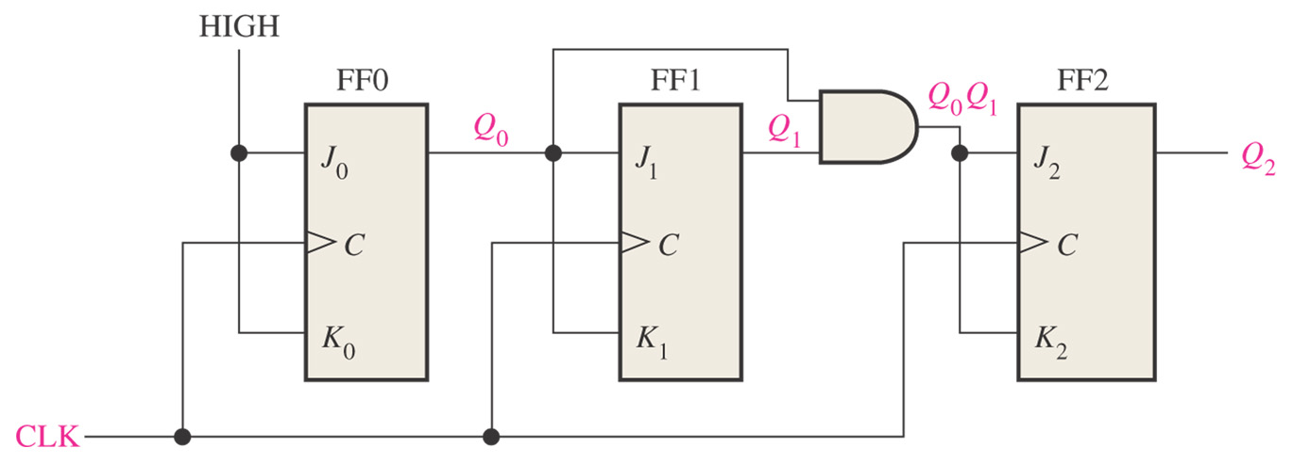
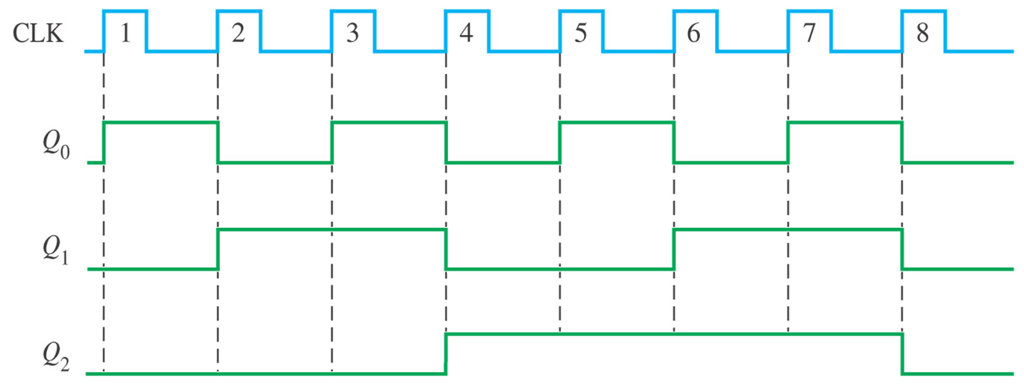
Figure 8–14 A 3-bit synchronous binary counter.

Slide 19
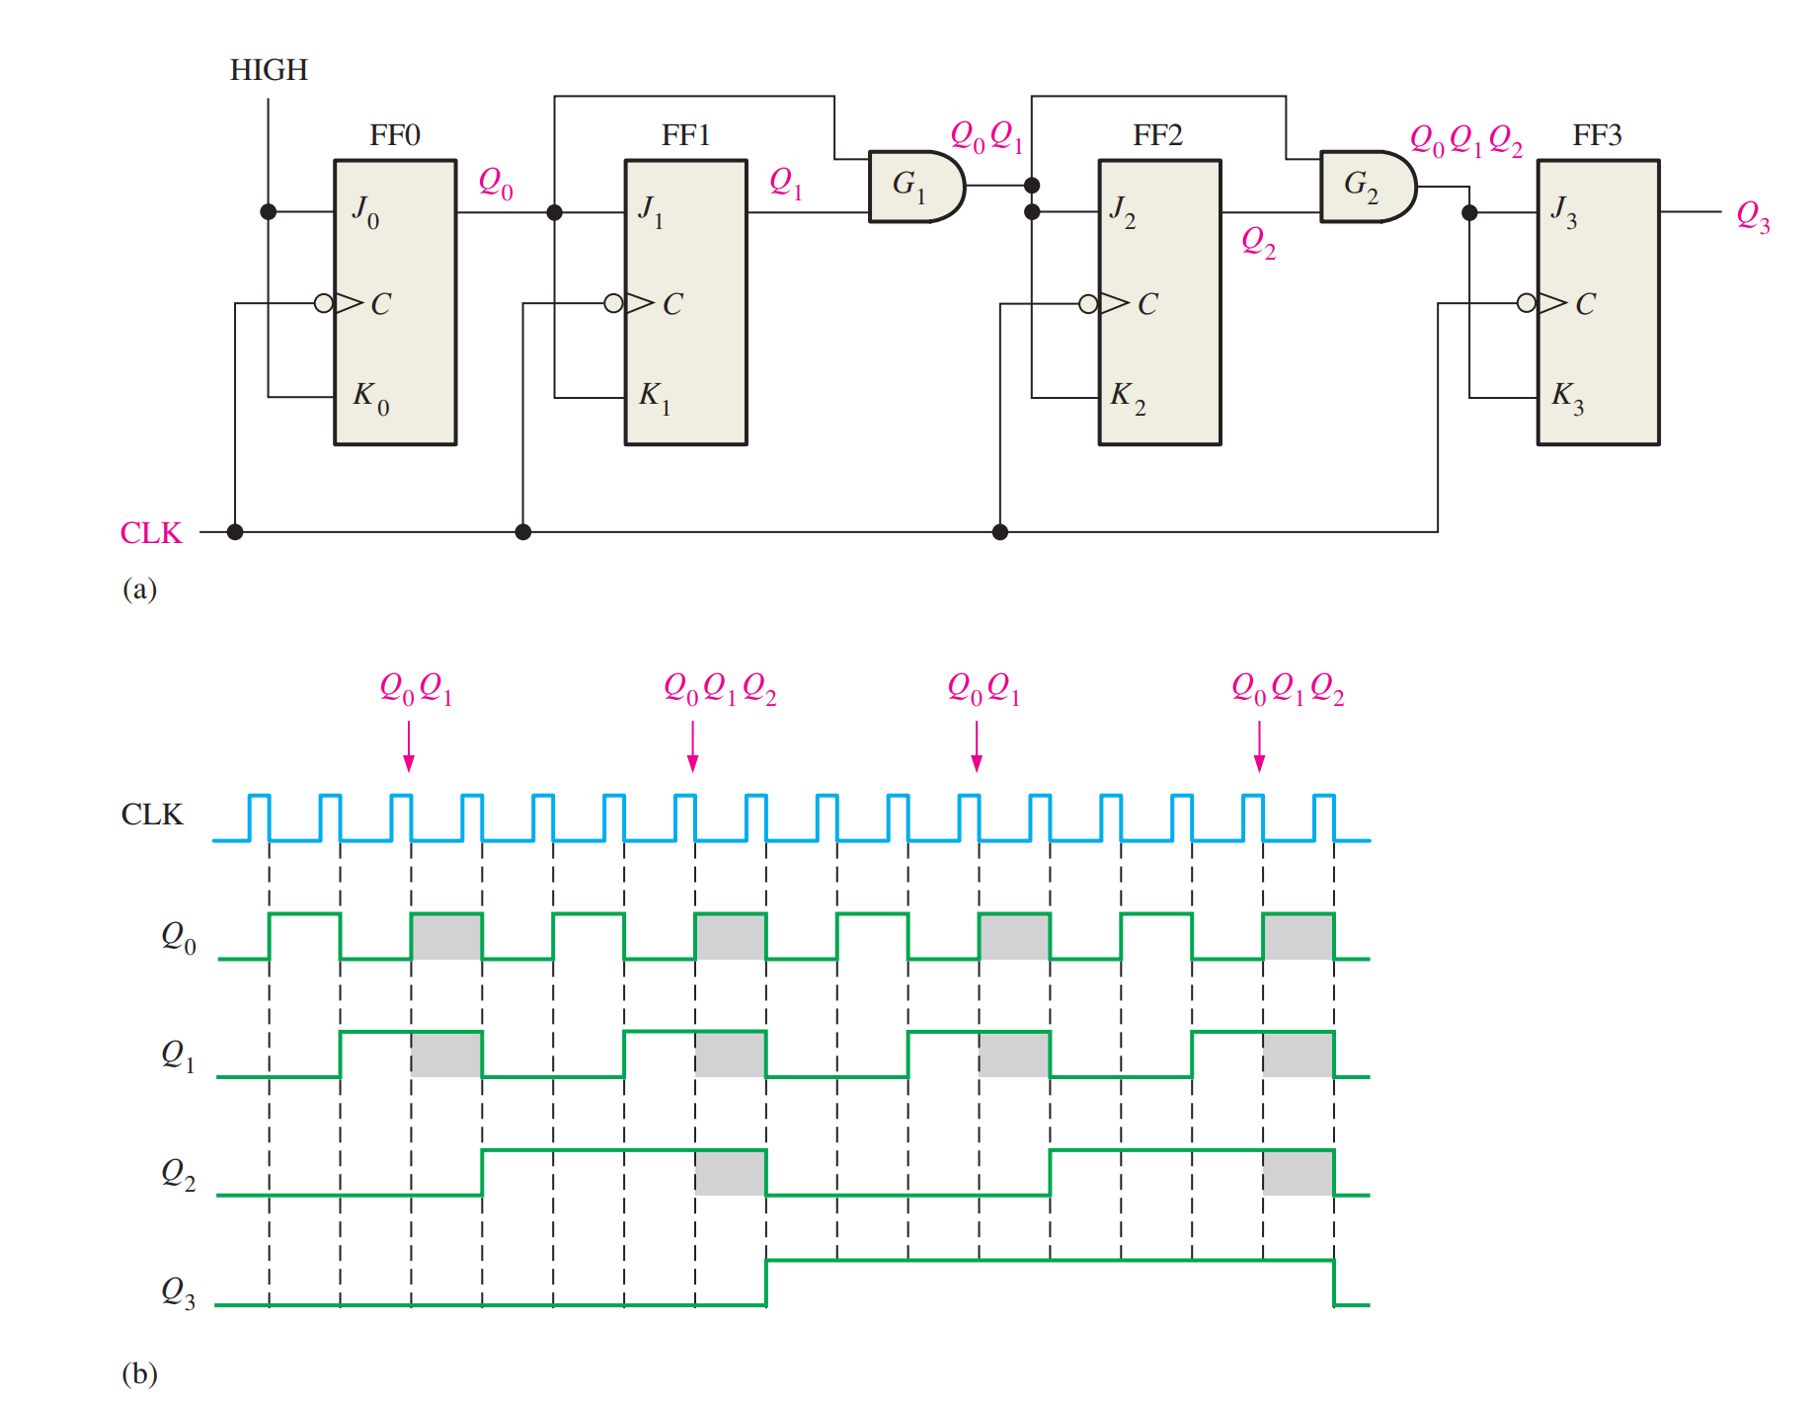

Slide 20
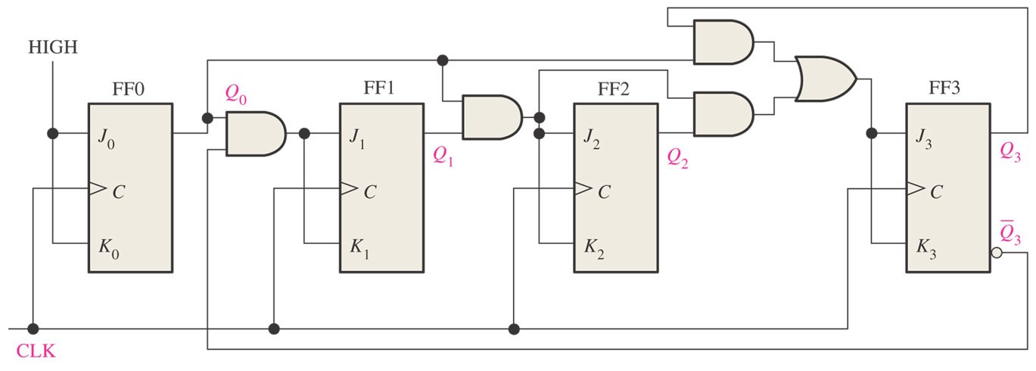
What is the function of the counter below?

Slide 21
Figure 8–17 A synchronous BCD decade counter.

Slide 22
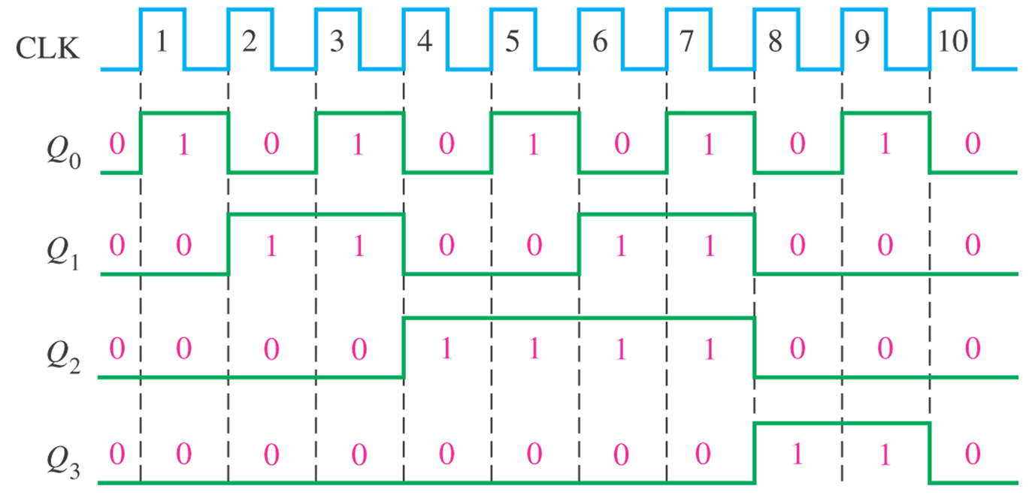

Slide 23
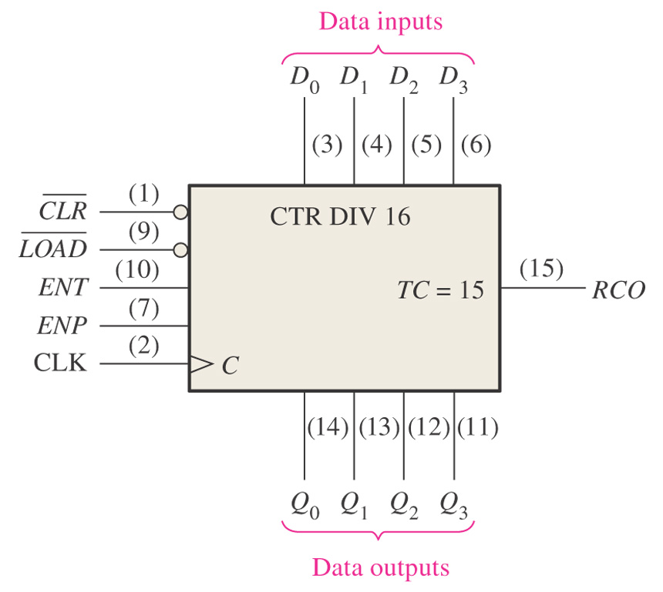
Figure 8–19 The 74HC163 4-bit synchronous binary counter.
: Load inputs (S)
: Clear inputs (S)
: Enable inputs
: Goes High when the counter reaches the last state in its sequence of fifteen.

Slide 24
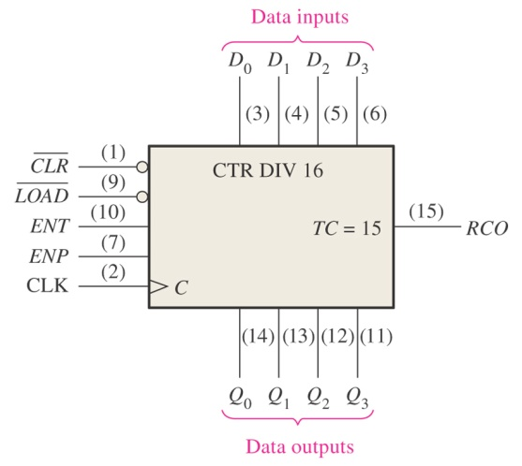
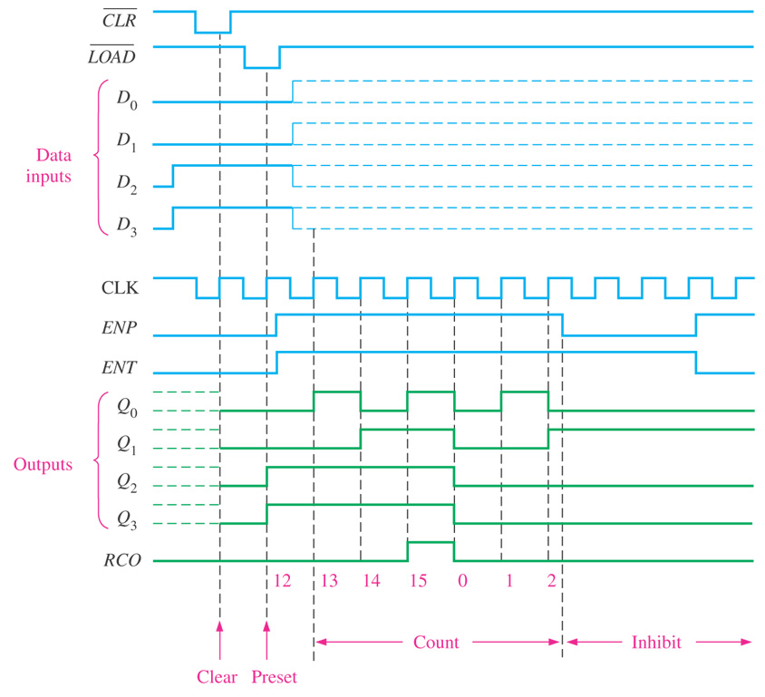
Figure 8–20 Timing example for a 74HC163.

Slide 25
8.3 Up/Down Synchronous Counters (加/减同步计数器)
Be capable of progressing in either direction through a certain sequence.
Also be called as a bidirectional counter

Slide 26
Up/Down sequence for a 3-bit binary counter
CLOCK PULSE | UP | Q2 | Q1 | Q0 | DOWN
0 |  | 0 | 0 | 0
1 |  | 0 | 0 | 1
2 |  | 0 | 1 | 0
3 |  | 0 | 1 | 1
4 |  | 1 | 0 | 0
5 |  | 1 | 0 | 1
6 |  | 1 | 1 | 0
7 |  | 1 | 1 | 1

Slide 27
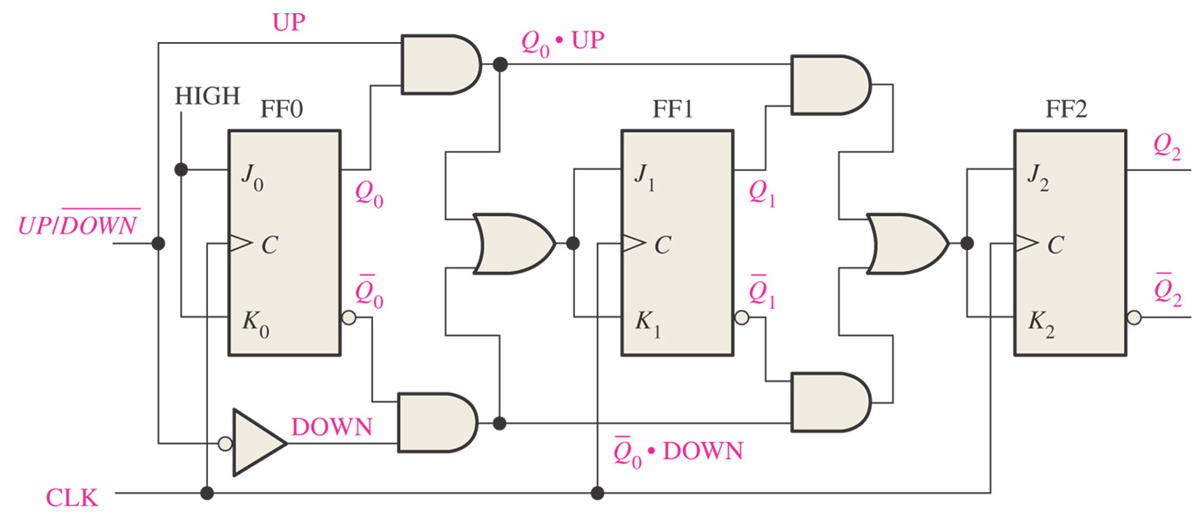
Figure 8–23 A basic 3-bit up/down synchronous counter.

Slide 28
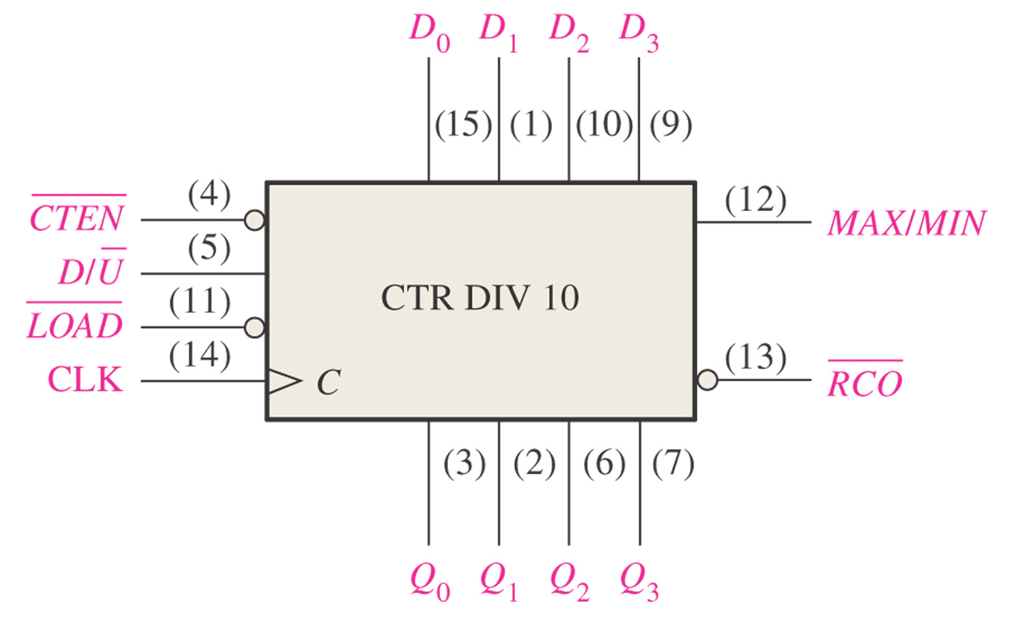
Figure 8–25 The 74HC190 up/down synchronous decade counter (十进制计数器).
Produces a HIGH pulse when the terminal count nine (1001) is reached in the UP mode or when the terminal count zero (0000) is reached in the DOWN mode.
Count enable input
Ripple clock output

Slide 29
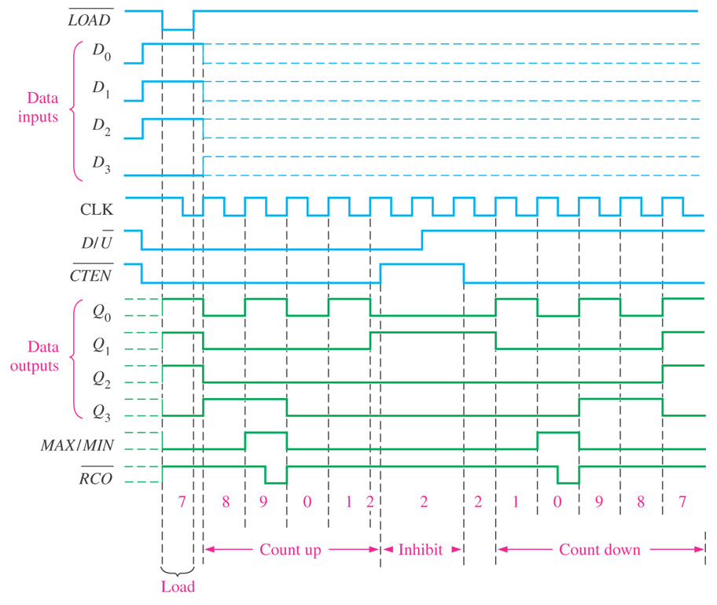
Figure 8–26 Timing example for a 74HC190.

Slide 30
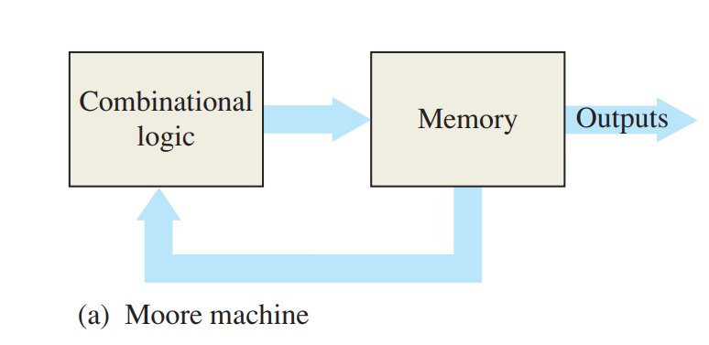
8.4 Design of Synchronous Counters
Moore circuits (摩尔型有限状态机)
  The output or outputs depend only on the present internal state

Slide 31
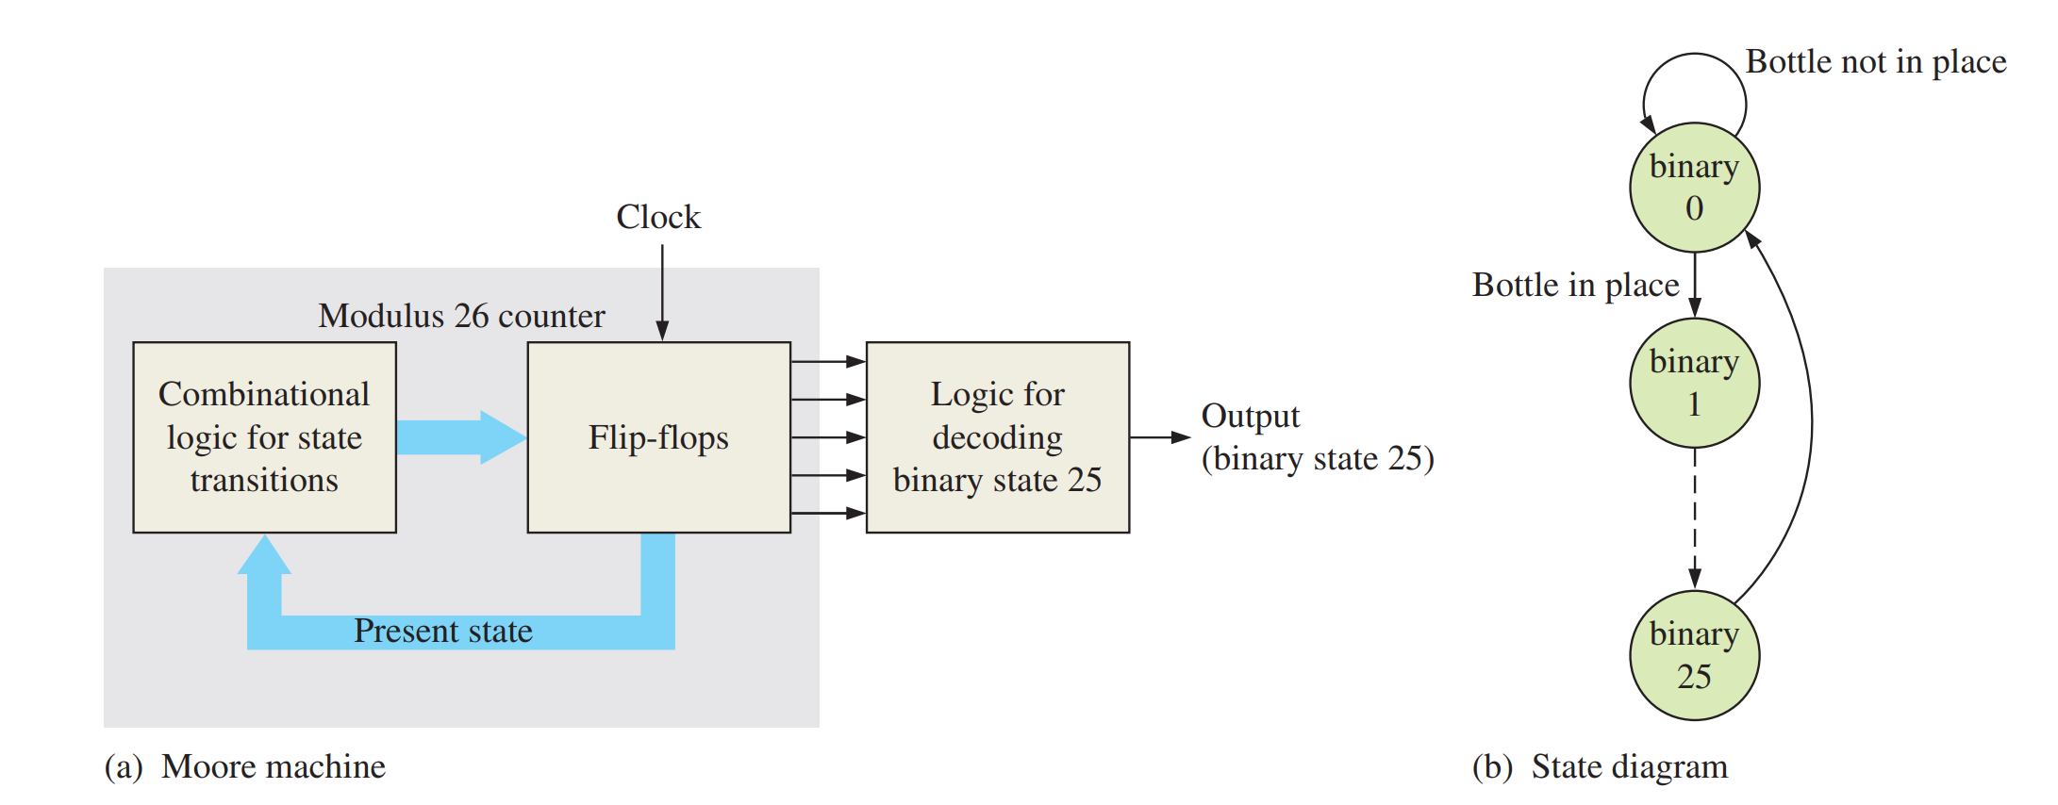
Moore Machine

Slide 32
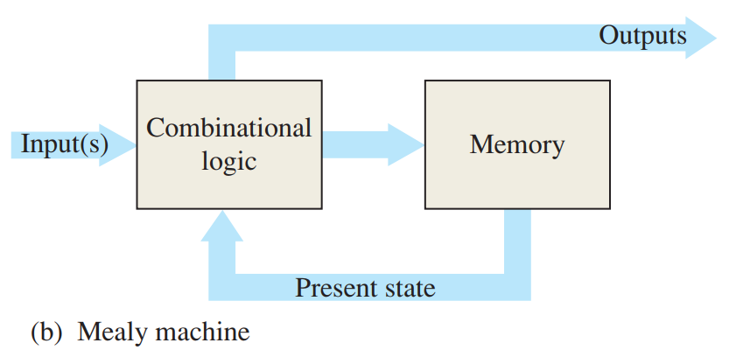
Mealy circuits (米利型有限状态机)
  The output or outputs depend on both the present state and the input or inputs

Slide 33
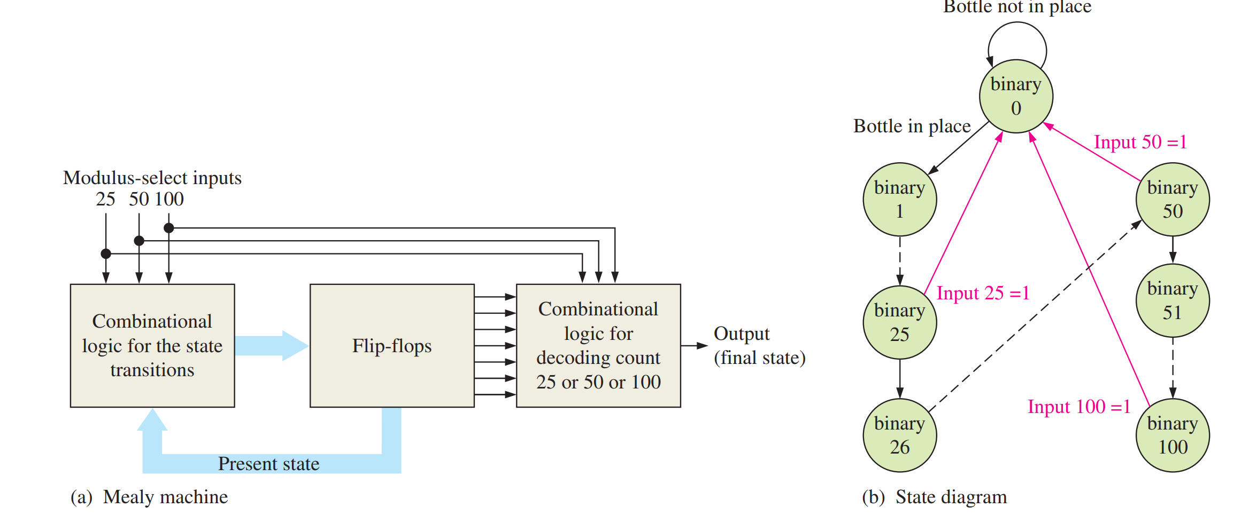
Mealy Machine

Slide 34
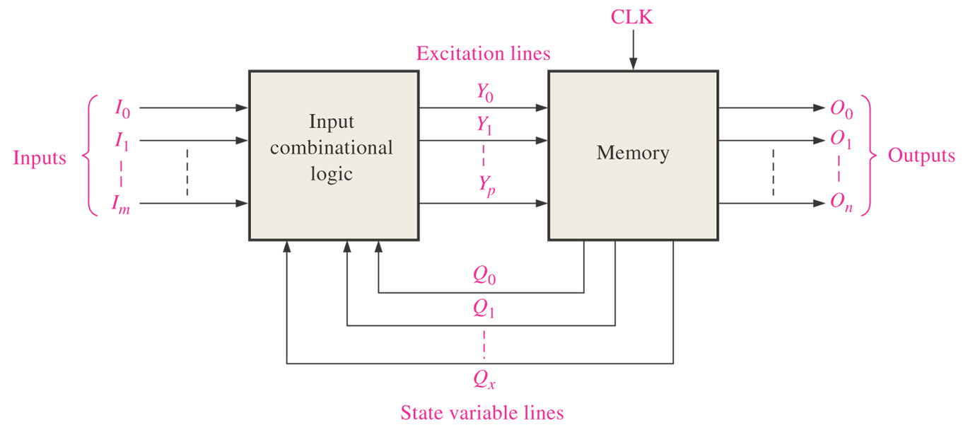

Slide 35
A general design procedure for sequential circuits
State Diagram
Next-State Table
Flip-Flop Transition Table
Karnaugh Maps
Logic Expressions for Flip-Flop Inputs
Counter Implementation

Slide 36
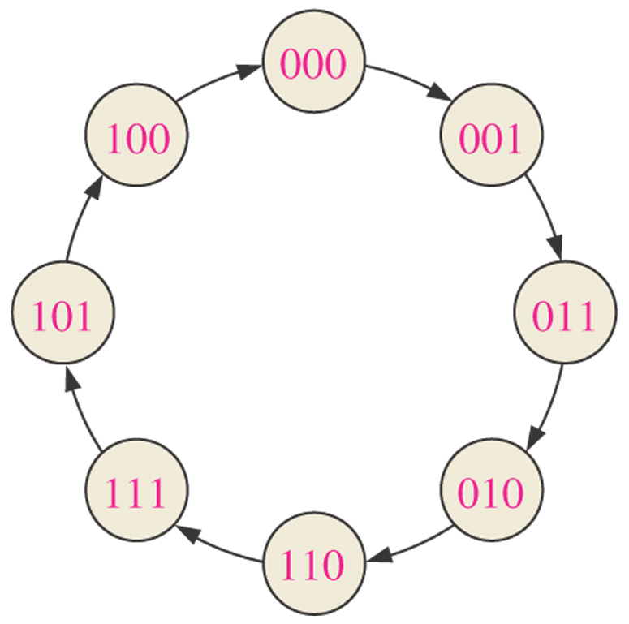
Example: Design of a basic 3-bit Gray code counter.
Step 1: State Diagram

Slide 37
Step 2: Next-State Table
Present State |  |  | Next State
Q2 | Q1 | Q0 | Q2 | Q1 | Q0
0 | 0 | 0 | 0 | 0 | 1
0 | 0 | 1 | 0 | 1 | 1
0 | 1 | 1 | 0 | 1 | 0
0 | 1 | 0 | 1 | 1 | 0
1 | 1 | 0 | 1 | 1 | 1
1 | 1 | 1 | 1 | 0 | 1
1 | 0 | 1 | 1 | 0 | 0
1 | 0 | 0 | 0 | 0 | 0

Slide 38
Step 3: Flip-Flop Transition Table
Transition table for a J-K flip-flop
Output Transitions |  |  | Flip-Flop Inputs
QN |  | QN+1 | J | K
0 | → | 0 | 0 | X
0 | → | 1 | 1 | X
1 | → | 0 | X | 1
1 | → | 1 | X | 0
QN: present state
QN+1: next state
X: “don’t care”

Slide 39
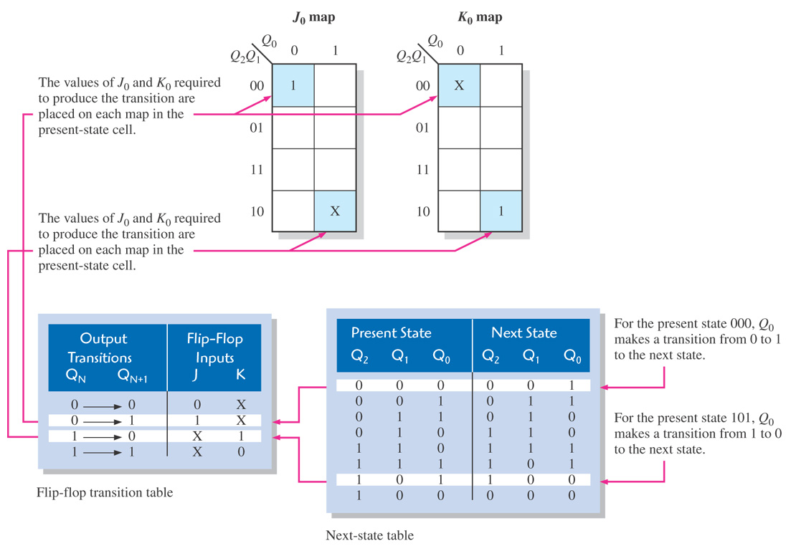
Step 4: Karnaugh Map

Slide 40
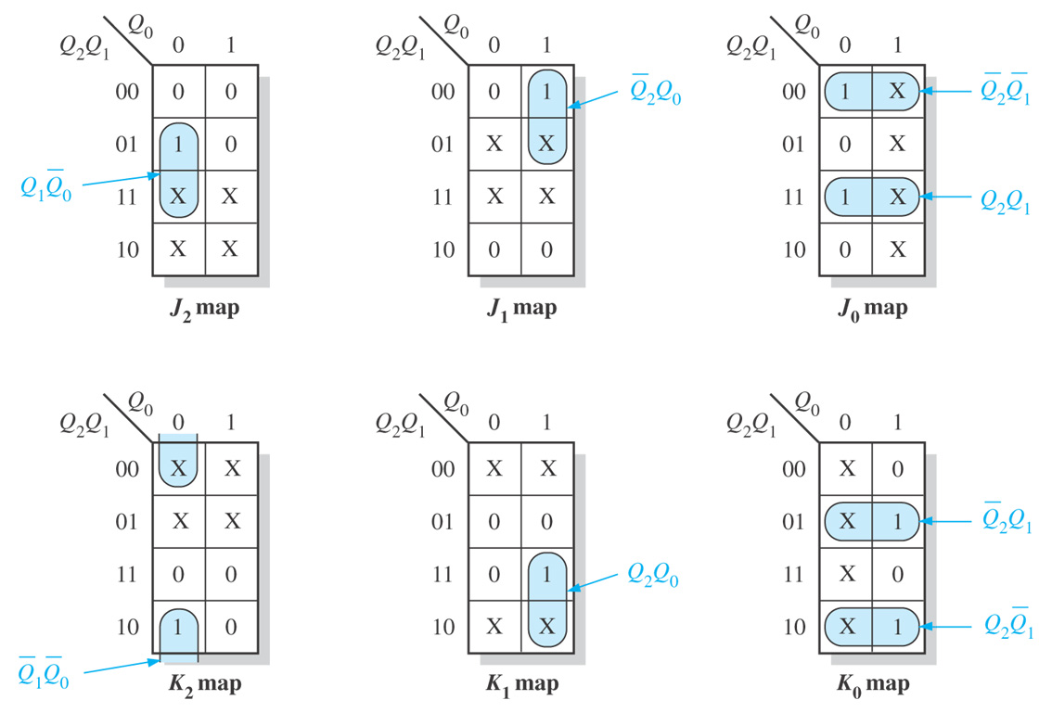

Slide 41
Step 5: Logic Expressions for Flip-Flop Inputs

Slide 42
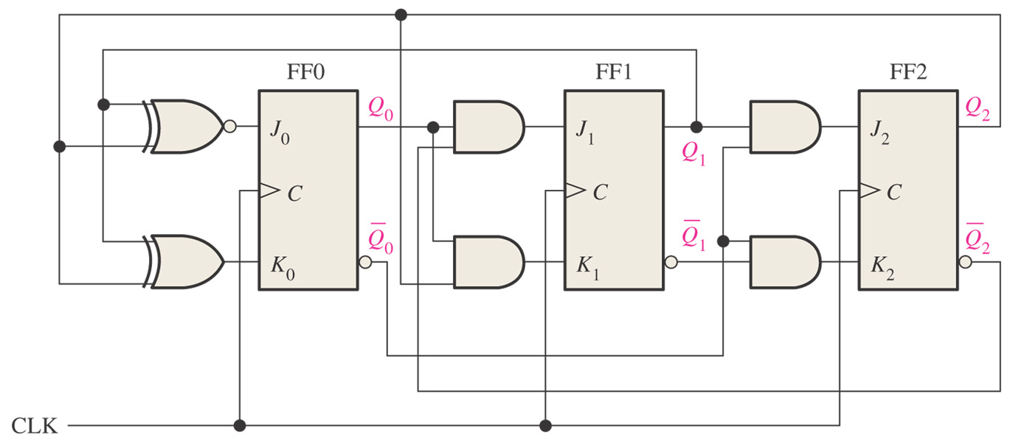
Step 6: Counter Implementation

Slide 43
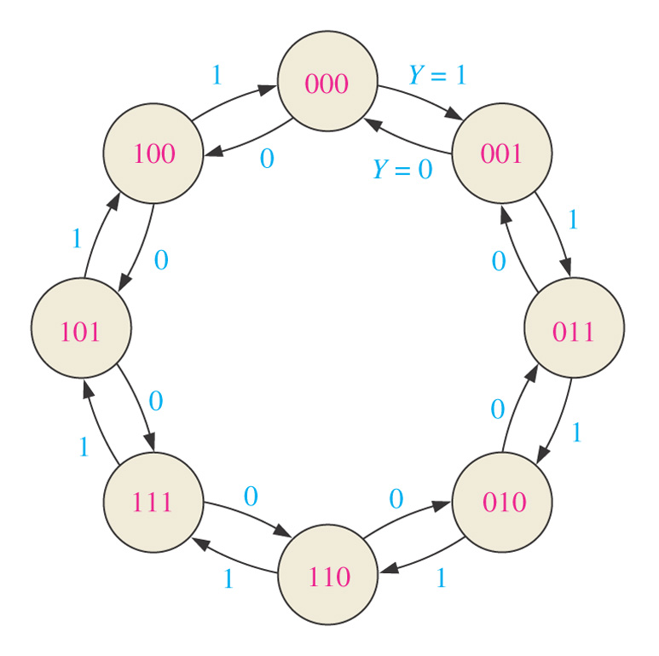
Example: Develop a synchronous 3-bit up/down counter with a Gray code sequence.
Step 1: State Diagram

Slide 44
Step 2: Next-State Table
Present State |  |  | Next State
Q2 | Q1 | Q0 | Y=0 (DOWN) |  |  | Y=1 (UP)
 |  |  | Q2 | Q1 | Q0 | Q2 | Q1 | Q0
0 | 0 | 0 | 1 | 0 | 0 | 0 | 0 | 1
0 | 0 | 1 | 0 | 0 | 0 | 0 | 1 | 1
0 | 1 | 1 | 0 | 0 | 1 | 0 | 1 | 0
0 | 1 | 0 | 0 | 1 | 1 | 1 | 1 | 0
1 | 1 | 0 | 0 | 1 | 0 | 1 | 1 | 1
1 | 1 | 1 | 1 | 1 | 0 | 1 | 0 | 1
1 | 0 | 1 | 1 | 1 | 1 | 1 | 0 | 0
1 | 0 | 0 | 1 | 0 | 1 | 0 | 0 | 0

Slide 45
Step 3: Flip-Flop Transition Table
Transition table for a J-K flip-flop
Output Transitions |  |  | Flip-Flop Inputs
QN |  | QN+1 | J | K
0 | → | 0 | 0 | X
0 | → | 1 | 1 | X
1 | → | 0 | X | 1
1 | → | 1 | X | 0
QN: present state
QN+1: next state
X: “don’t care”

Slide 46
Present State |  |  | Next State
Q2 | Q1 | Q0 | Y=0 (DOWN) |  |  | Y=1 (UP)
 |  |  | Q2 | Q1 | Q0 | Q2 | Q1 | Q0
0 | 0 | 0 | 1 | 0 | 0 | 0 | 0 | 1
0 | 0 | 1 | 0 | 0 | 0 | 0 | 1 | 1
0 | 1 | 1 | 0 | 0 | 1 | 0 | 1 | 0
0 | 1 | 0 | 0 | 1 | 1 | 1 | 1 | 0
1 | 1 | 0 | 0 | 1 | 0 | 1 | 1 | 1
1 | 1 | 1 | 1 | 1 | 0 | 1 | 0 | 1
1 | 0 | 1 | 1 | 1 | 1 | 1 | 0 | 0
1 | 0 | 0 | 1 | 0 | 1 | 0 | 0 | 0

Slide 47
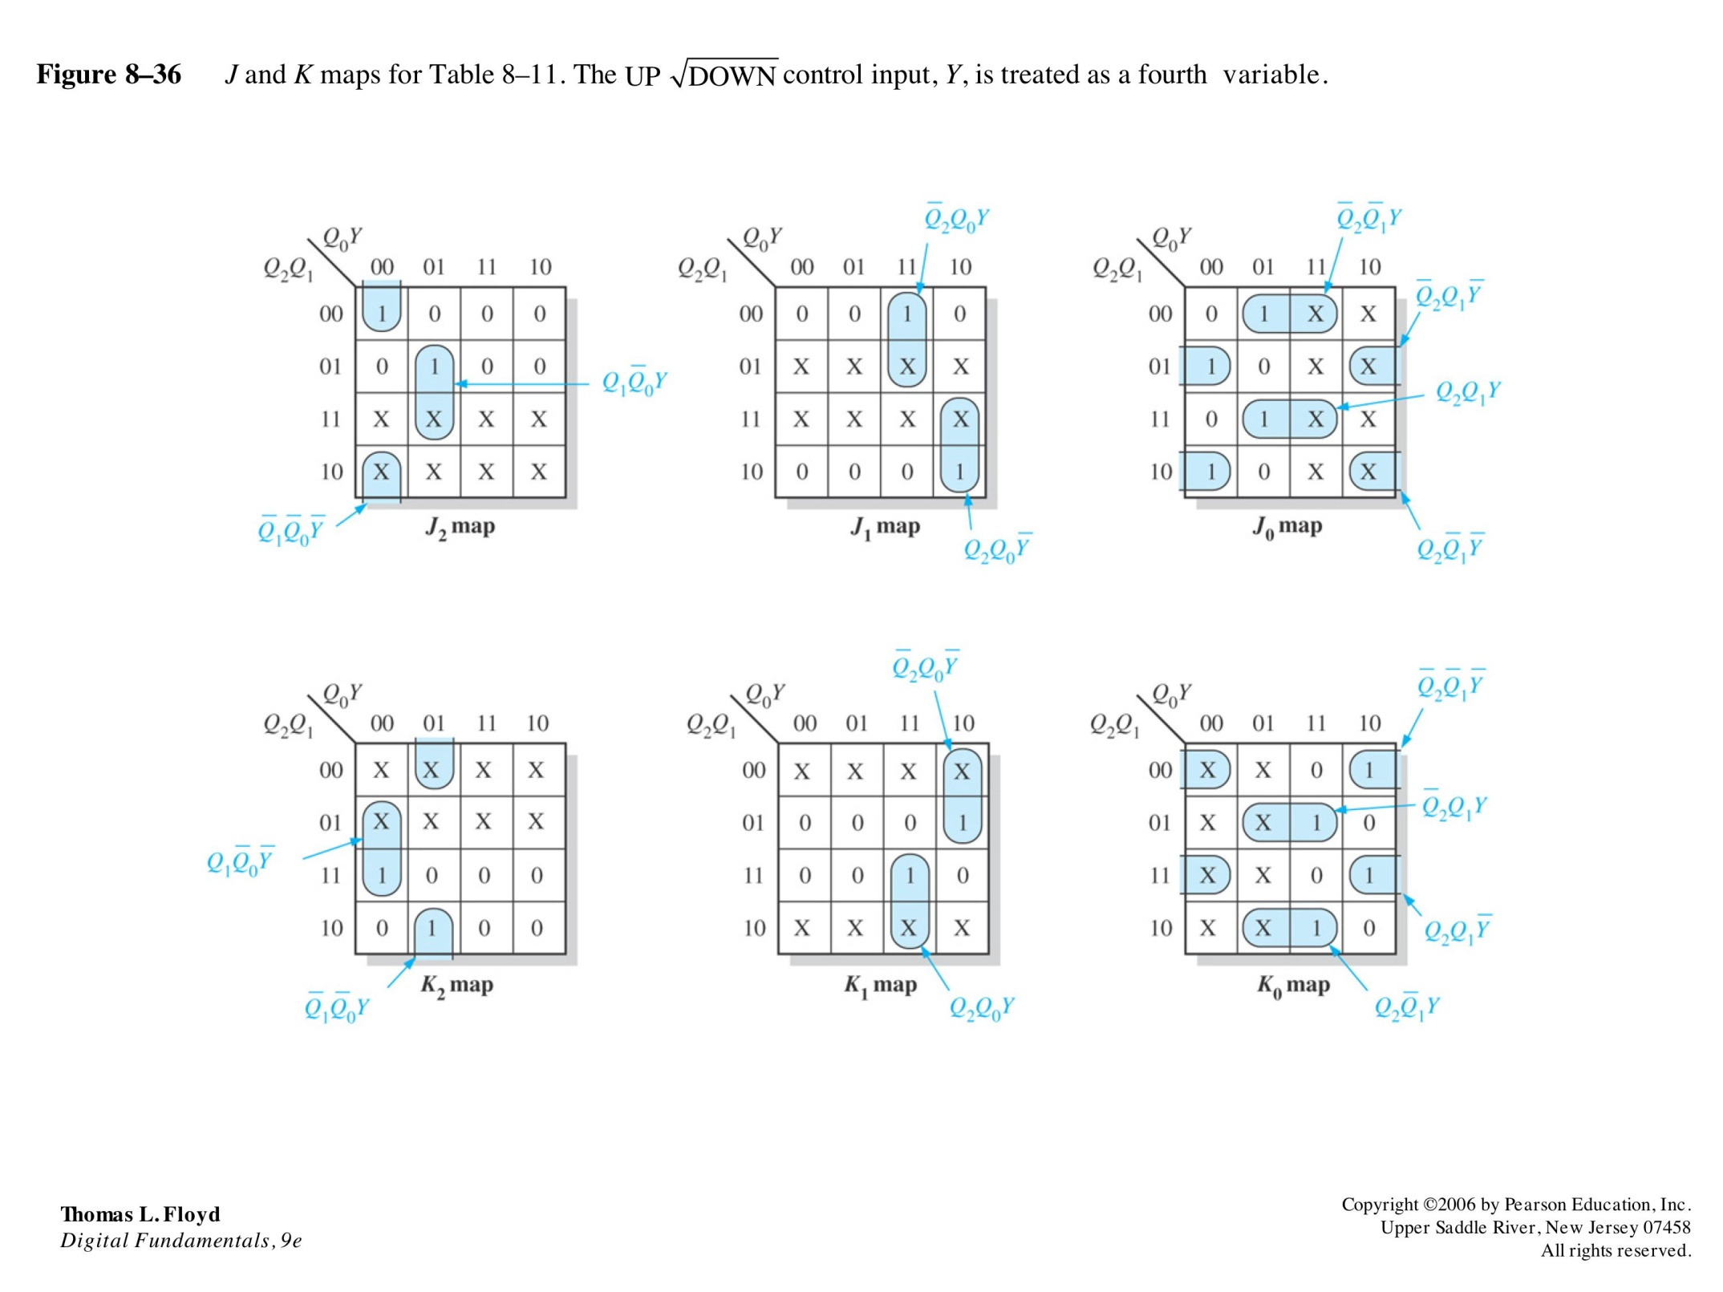
Step 4: Karnaugh Map

Slide 48
Step 5: Logic Expressions for Flip-Flop Inputs

Slide 49
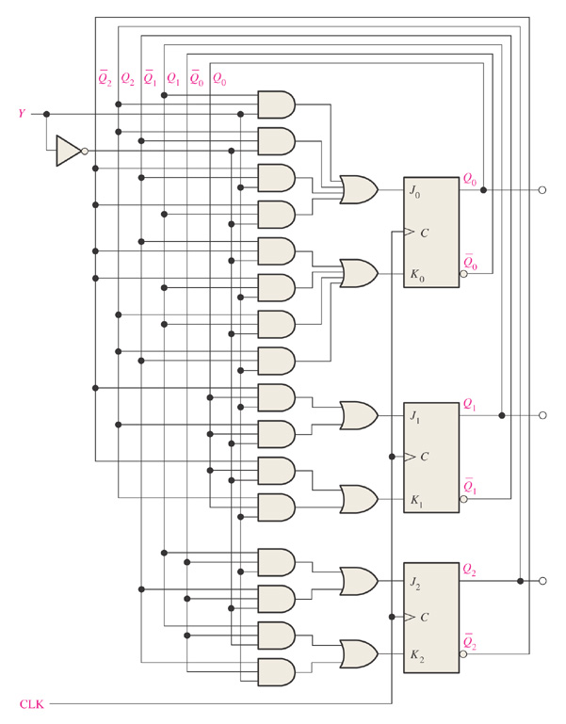
Step 6: Counter Implementation

Slide 50
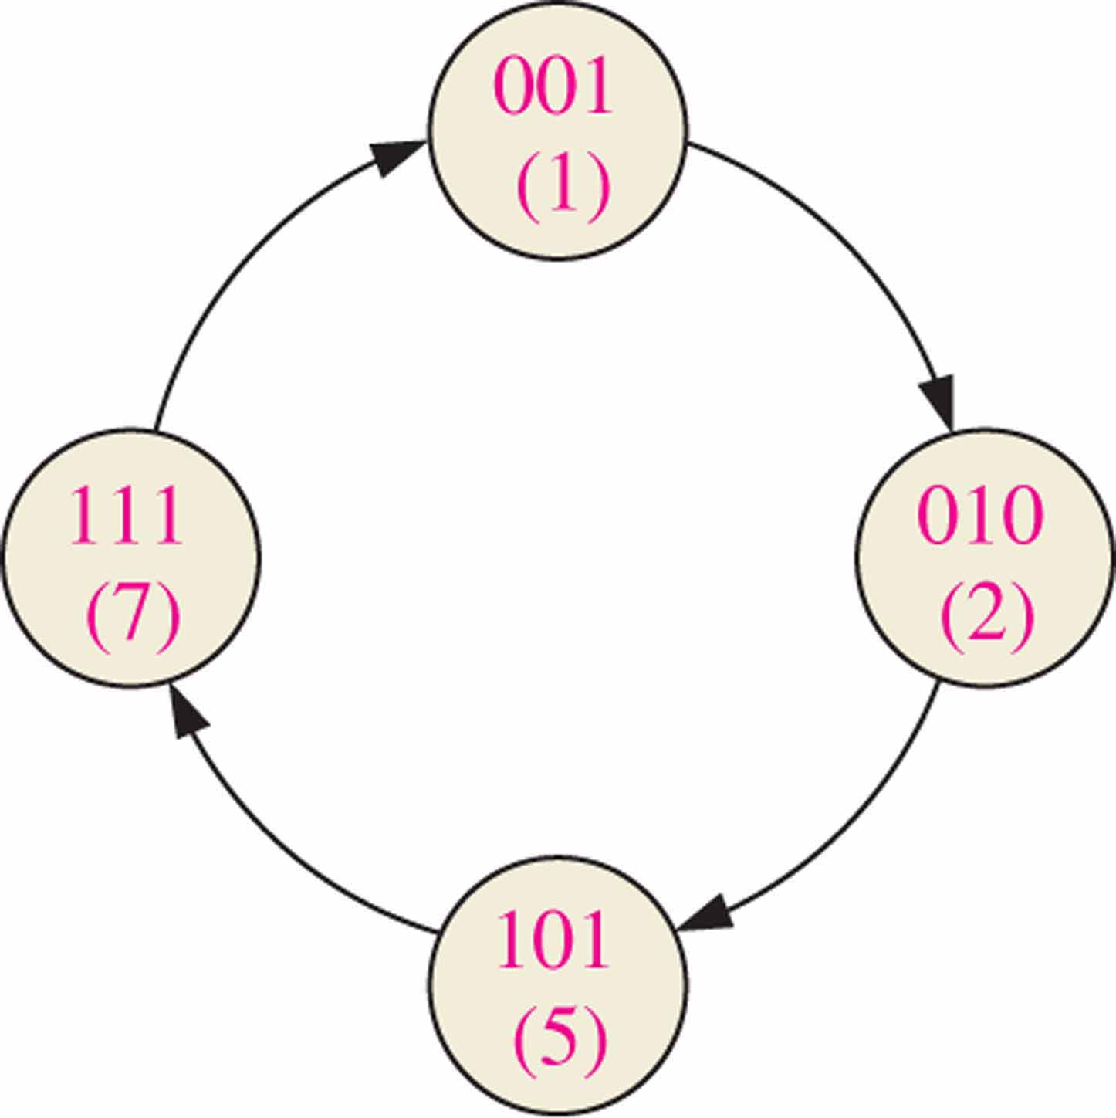
Example
Design a counter with the following counting sequence:
001→010→101→111→001…
Solution
(1) Determine the next state table
Current State |  |  | Next State
Q2 | Q1 | Q0 | Q2 | Q1 | Q0
0 | 0 | 1 | 0 | 1 | 0
0 | 1 | 0 | 1 | 0 | 1
1 | 0 | 1 | 1 | 1 | 1
1 | 1 | 1 | 0 | 0 | 1

Slide 51
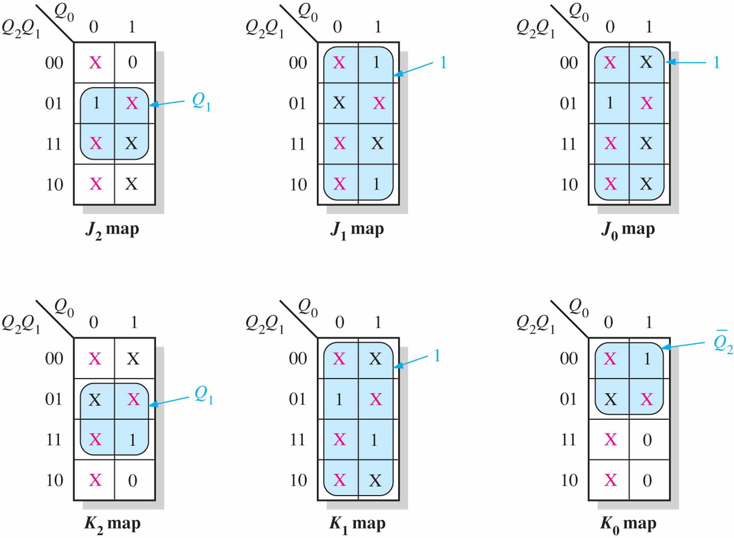
(2) Find the K-maps for all J-K FFs

Slide 52
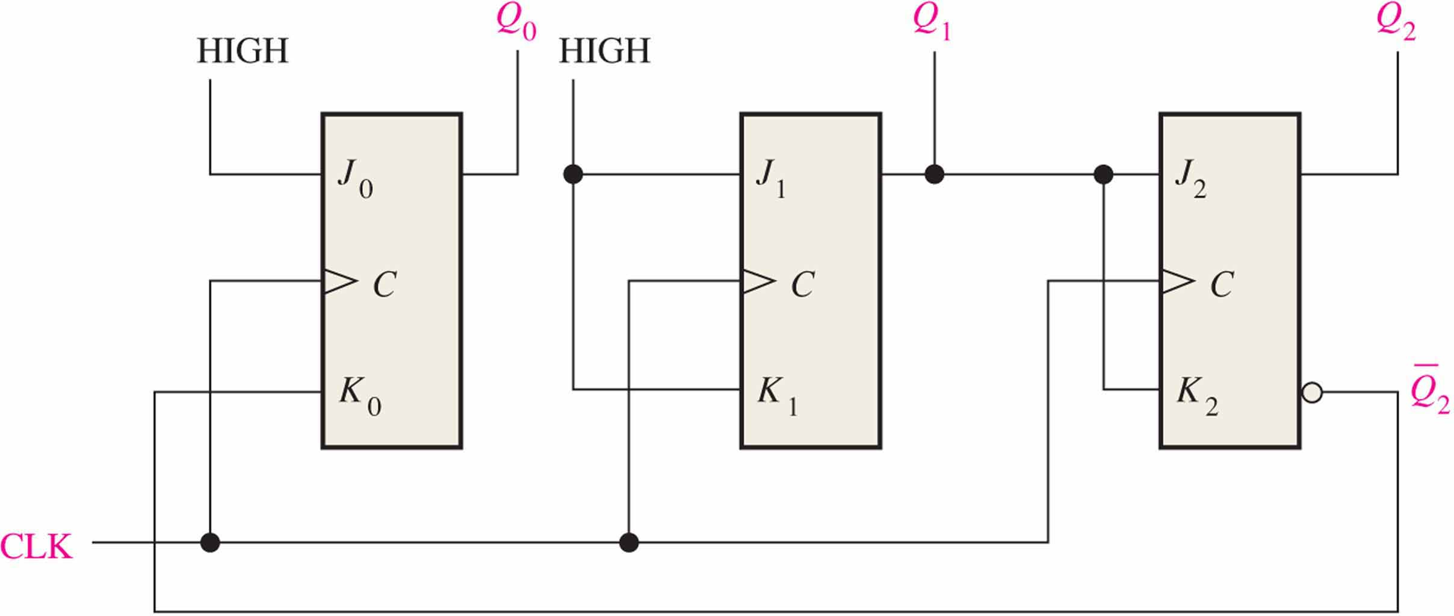
(3) Draw the circuit

Slide 53
(4) Check whether the circuit is able to self start (Optional)
Determine if the circuit is able to enter one of the desired states (in the state diagram) after a finite number of transitions.
If it can not, you may have to re-design the circuit.

Slide 54
8.5 Cascaded Counters
Connect counter to achieve higher-modulus operation
Cascading
  The last-stage output of one counter drives the input of the next counter

Slide 55
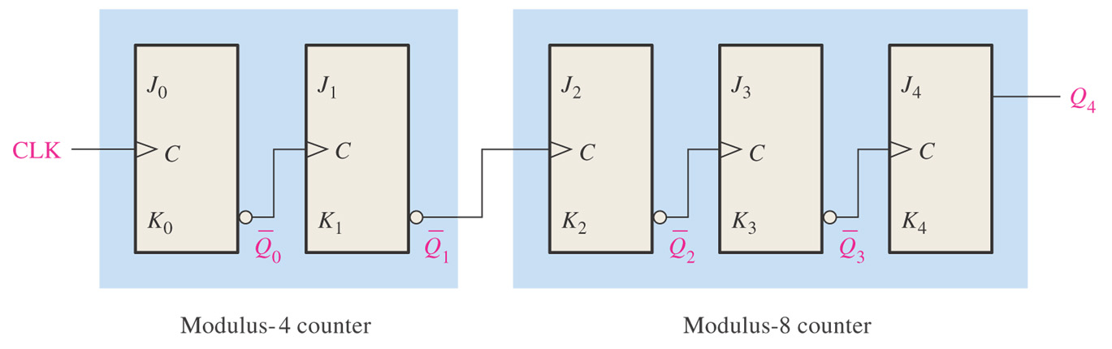
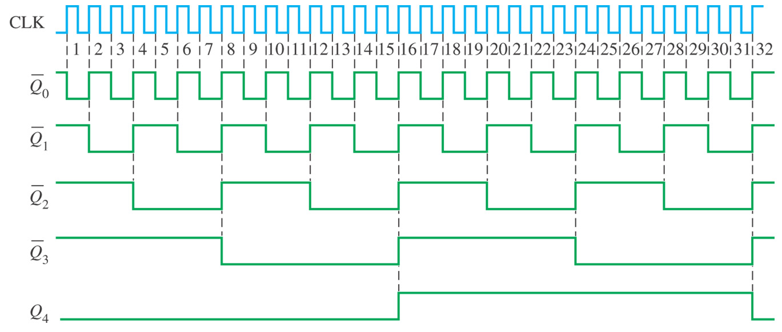
Figure 8–38 Two cascaded counters (all J and K inputs are HIGH).

Slide 56
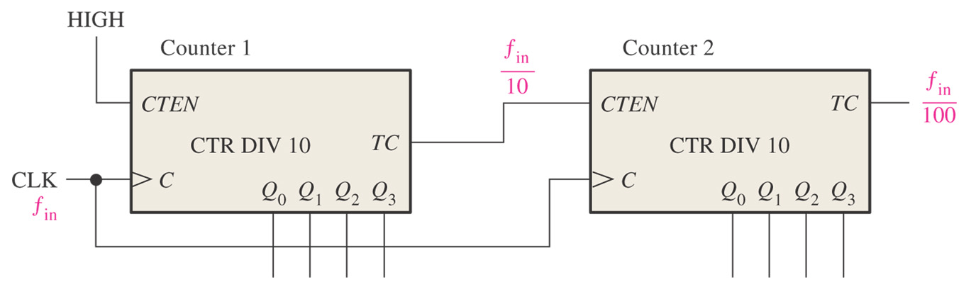
Figure 8–40 A modulus-100 counter using two cascaded decade counters.

Slide 57
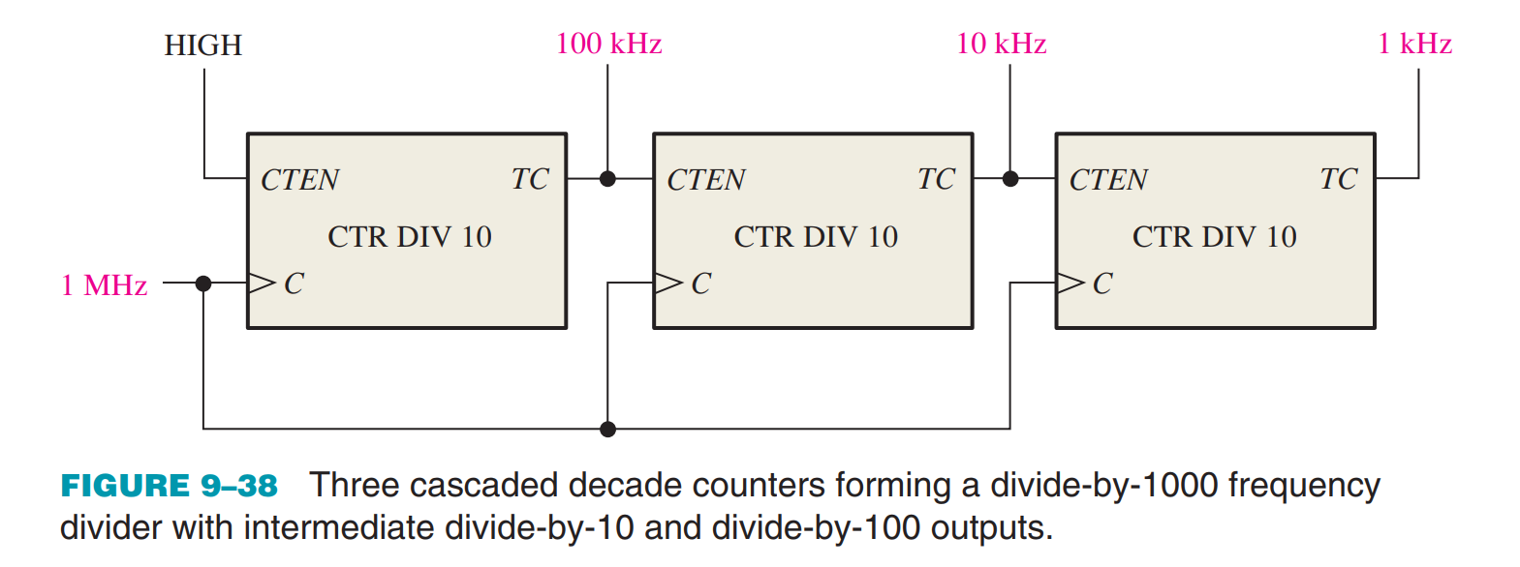

Slide 58
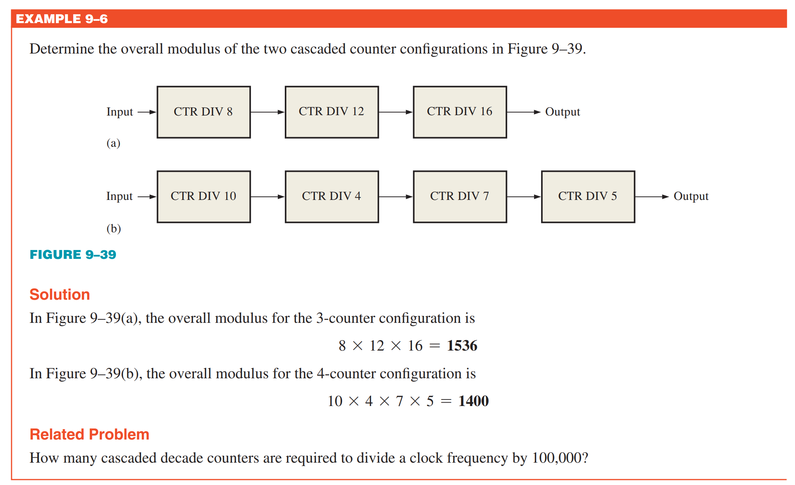

Slide 59
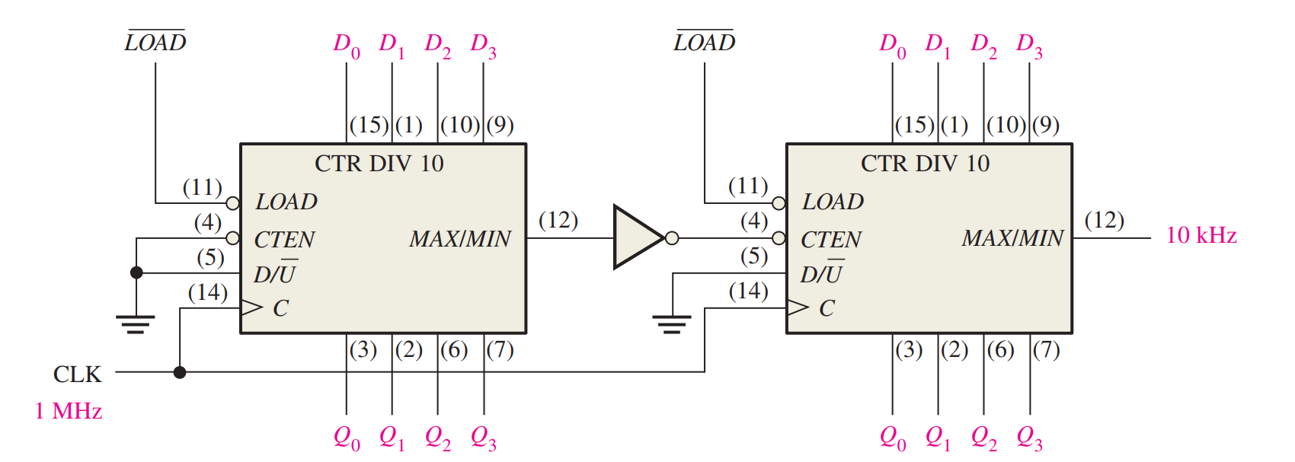
Use 74HC190 up/down decade counters connected in the UP mode to obtain a 10 kHz waveform from a 1 MHz clock. Show the logic diagram

Slide 60
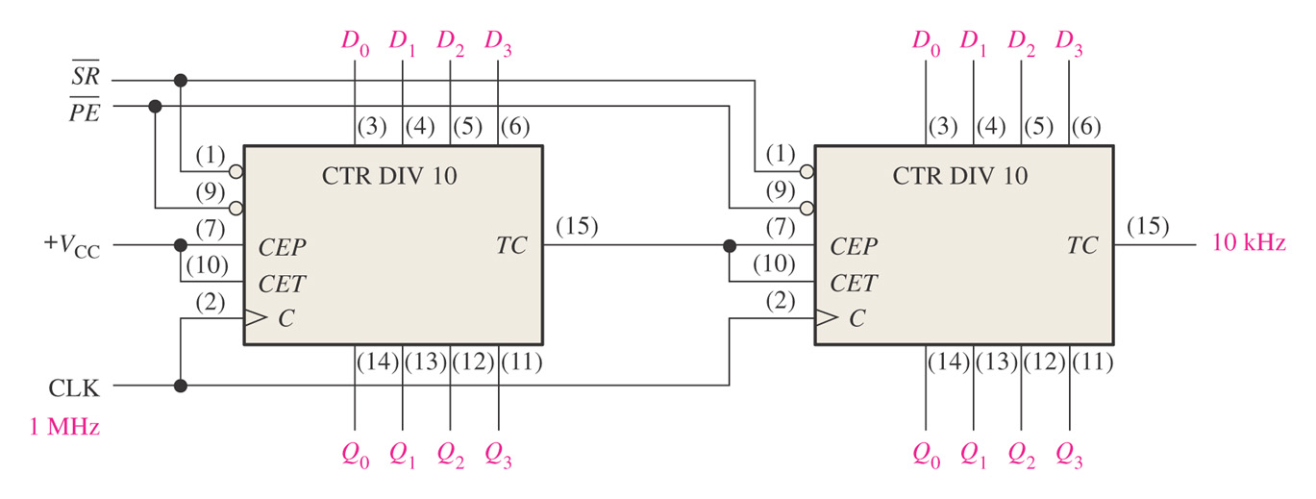
Figure 8–43 A divide-by-100 counter using two 74F162 decade counters.

Slide 61
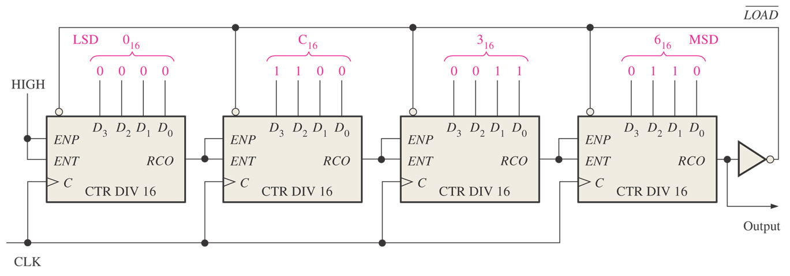
Cascaded Counters with Truncated Sequences
Figure 8–44 A divide-by-40,000 counter using 74HC161 4-bit binary counters. Note that each of the parallel data inputs is shown in binary order (the right-most bit D₀ is the LSB in each counter).

Slide 62
8.6 Counter Decoding

Slide 63

Figure 8–45 Decoding of state 6 (110).

Slide 64

Figure 8–46 A 3-bit counter with active-HIGH decoding of count 2 and count 7.

Slide 65

Decoding Glitches

Slide 66



Slide 67
8.7 Counter Applications

Slide 68

Figure 8–51 Simplified logic diagram for a 12-hour digital clock.

Slide 69

Figure 8–52 Logic diagram of typical divide-by-60 counter using 74F162 synchronous decade counters. Note that the outputs are in binary order (the right-most bit is the LSB).
: Asynchronously reset the counter

Slide 70

Figure 8–53 Logic diagram for hours counter and decoders. Note that on the counter inputs and outputs, the right-most bit is the LSB.
: Synchronously preset the counter

Slide 71

Application 2: Automobile Parking Control

Slide 72


Slide 73

Application 3: Parallel-to-Serial Data Conversion (Multiplexing)

Slide 74


Slide 75
Summary
Asynchronous counter and synchronous counter
  concepts
Up/down synchronous counter
How to design a synchronous counter?
  methods
Cascaded counter
  methods
Applications

Slide 76


Quiz
1. The counter shown below is an example of
a. an asynchronous counter
b. a BCD counter
c. a synchronous counter
d. none of the above
HIGH
J₀
Q₀
J₁
Q₁
J₂
Q₂
CLK
C
C
C
Q₀
Q₁
K₀
K₁
K₂
© 2008 Pearson Education

Slide 77
Quiz
The Q₀ output of the counter shown
a. is present before Q₁ or Q₂
b. changes on every clock pulse
c. has a higher frequency than Q₁ or Q₂
d. all of the above
HIGH
J₀
Q₀
J₁
Q₁
J₂
Q₂
CLK
C
C
C
Q₀
Q₁
K₀
K₁
K₂
© 2008 Pearson Education

Slide 78
Quiz
3. To cause a D flip-flop to toggle, connect the
a. clock to the D input
b. Q output to the D input
c. Q output to the D input
d. clock to the preset input
© 2008 Pearson Education

Slide 79

Quiz
4. The 7493A asynchronous counter diagram is shown (J’s and K’s are HIGH.) To make the count have a modulus of 16, connect
a. Q₀ to RO(1) and RO(2) to
b. Q₃ to RO(1) and RO(2)
c. CLK A and CLK B together
d. Q₀ to CLK B
© 2008 Pearson Education

Slide 80
Quiz
5. Assume Q₀ is LOW. The next clock pulse will cause
a. FF1 and FF2 to both toggle
b. FF1 and FF2 to both latch
c. FF1 to latch; FF2 to toggle
d. FF1 to toggle; FF2 to latch
FF0
FF1
FF2
LOW
© 2008 Pearson Education

Slide 81
Quiz
6. A 4-bit binary counter has a terminal count of
a. 4
b. 10
c. 15
d. 16
© 2008 Pearson Education

Slide 82
Quiz
7. Assume the clock for a 4-bit binary counter is 80 kHz. The output frequency of the fourth stage (Q₃) is
a. 5 kHz
b. 10 kHz
c. 20 kHz
d. 320 kHz
© 2008 Pearson Education

Slide 83

Quiz
8. A 3-bit count sequence is shown for a counter (Q₂ is the MSB). The sequence is
a. 0-1-2-3-4-5-6-7-0 (repeat)
b. 0-1-3-2-6-7-5-4-0 (repeat)
c. 0-2-4-6-1-3-5-7-0 (repeat)
d. 0-4-6-2-3-7-5-1-0 (repeat)
Q₀
Q₁
Q₂
© 2008 Pearson Education

Slide 84
Quiz
9. FF2 represents the MSB. The counts that are being decoded by the 3-input AND gates are
a. 2 and 3
b. 3 and 6
c. 2 and 5
d. 5 and 6
© 2008 Pearson Education

Slide 85
Quiz
10. Assume the input frequency (f_{in}) is 256 Hz. The output frequency (f_{out}) will be
a. 16 Hz
b. 1 kHz
c. 65 kHz
d. none of the above
HIGH
Counter 1
Counter 2
f_{out}
CTEN
TC
CTEN
TC
CTR DIV 16
CTR DIV 16
CLK
C
Q₀
Q₂
Q₁
Q₃
C
Q₀
Q₂
Q₁
Q₃
f_{in}
© 2008 Pearson Education

